Slide 1
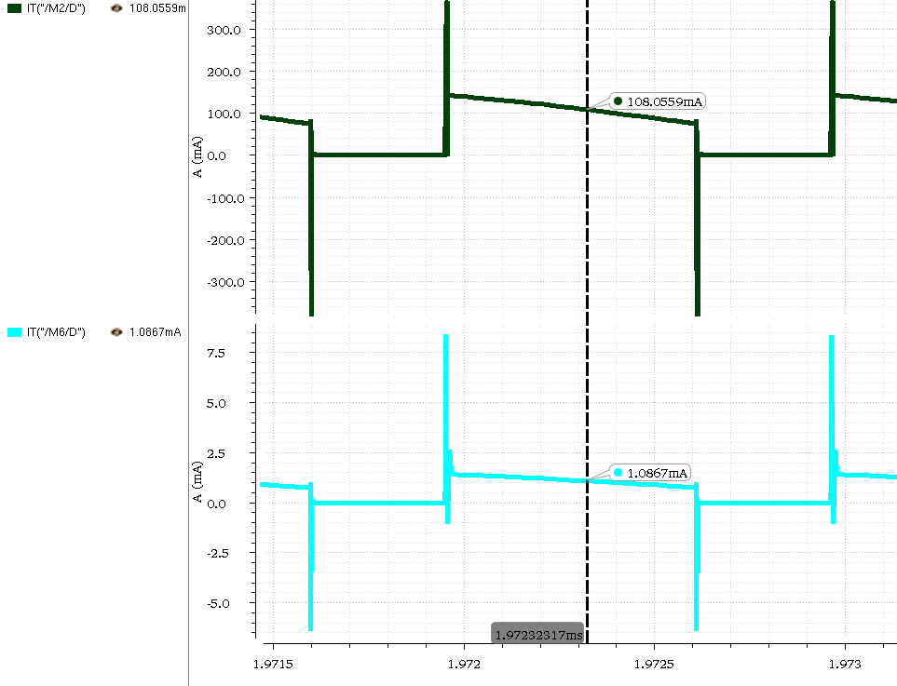
      Donghee Cho and Minkyu Je
      Department of Electrical Engineering, KAIST, KI B/D (E4) 415C, Daejeon, Korea Tel : +82-42-350-7437, E-mail address : dh456@kaist.ac.kr, mkje@kaist.ac.kr
Research Activities related to Attachable Phototherapeutics Center for e-Healthcare
A Boost OLED Driver with OLED current estimator by using the SenseFET
Introduction
In the light therapy system, the organic light emitting diode (OLED) is considered as a strong candidate because of its advantageous characteristics in mechanical flexibility as surface light source, uniformity, and power consumption. Because the OLED luminance is proportional to its forward current and the threshold voltage tends to shift by aging, the current through the OLED should be controlled instead of the applied voltage.
Motivation
Fig.2. SenseFET based OLED current estimator
Fig.1. A conventional OLED Driver.
Simulation Results
The brightness of OLED is proportional to its forward current.
The forward current of OLED is sensitive to forward bias voltage because of its nonlinear characteristics.
A conventional OLED Driver use a current driving to control the its brightness.
A Current regulation Elements cause power loss which degrade a power efficiency.
To achieve the high power efficiency a lossless current driving technique is required.
(a) Power switch
Circuit Implementation
By using the SenseFET as a current sensor, the current regulation element which incurs the additional power loss is removed.
The SenseFET based OLED current estimator can achieve the lossless current sensing by increasing the ratio of the SenseFET.
The OLED current estimator circuit integrates the current which flows through the power switch in a duty, and controls the duty ratio of the boost converter to regulate the current of OLED as a reference.
The high gain and large bandwidth amplifier is required to achieve the precise current sensing.
(b) SenseFET
Fig.3. Current sensing waveform of SenseFET
In 1 MHz switching frequency, the precise current sensing is achieved by using the OLED current estimator.
The integrated circuit is designed as continuous current mode(CCM), and the load current can be changed from 50 mA to 200 mA.
Summary & Conclusion & Acknowledgement
In the wearable light therapy system, the flexible battery which has the low output power is used. Therefore, the high efficiency of the OLED driver is required.
The SenseFET based OLED current estimator controls the OLED current without the additional power loss.
The chip fabrication was supported by the IC Design Education Center(IDEC), Korea.

